Slide 3
Book Recommendation System
The Purpose of the Book Recommendation System is to predict buyer’s interest and recommend books to them accordingly

Slide 4
Problem Statement

Slide 5
Data Summary
The Dataset is comprised of three csv files :
Users.csv
User-ID, Location, Age
Books.csv
ISBN, Book-Title, Book-Author, Year-Of-Publication, Publisher, Image-URL-S, Image-URL-M, Image-URL-L
Ratings.csv
User-ID, ISBN, Book-Rating

Slide 6
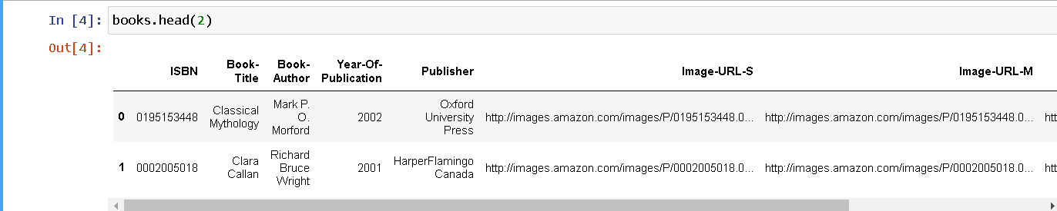
Books Data Preprocessing

Slide 7
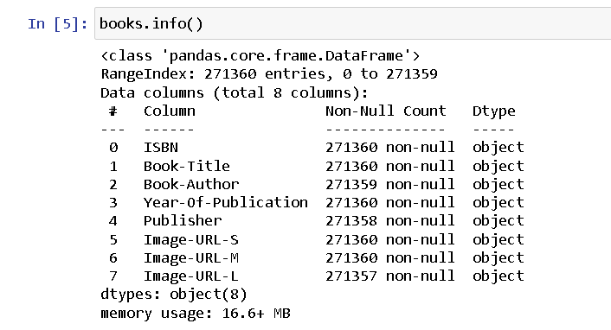
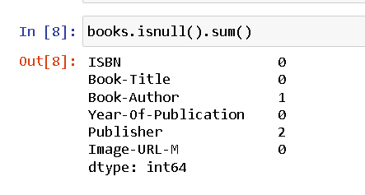
Null Values in Books Dataset

Slide 8
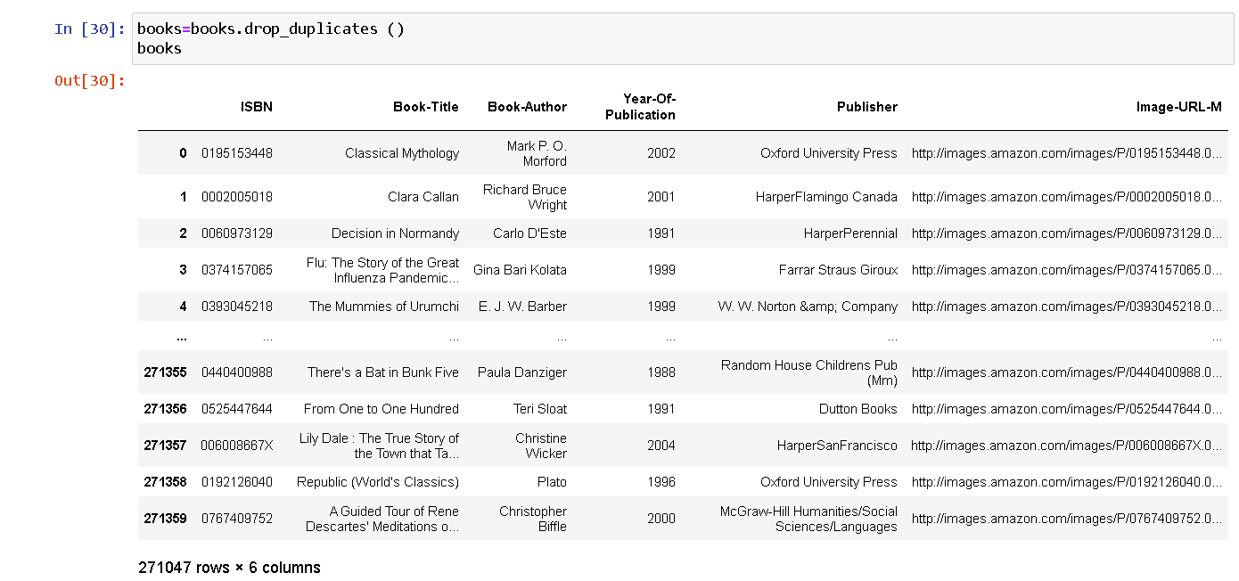
Drop Duplicate

Slide 9
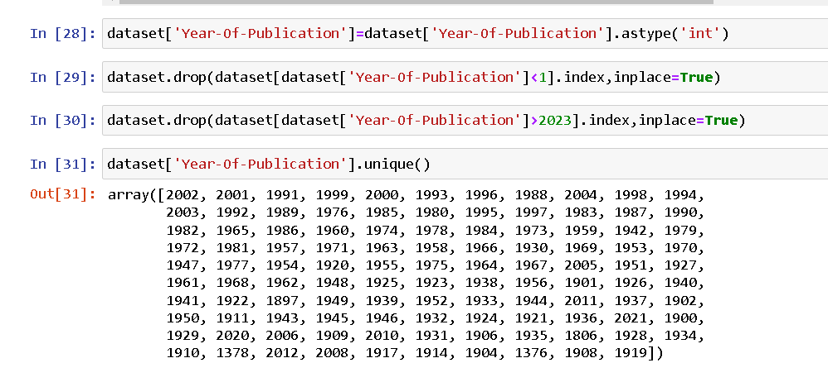
Replace the string value with int
Drop the Year of Publication value which were less than 1 and which were greater than 2023

Slide 10
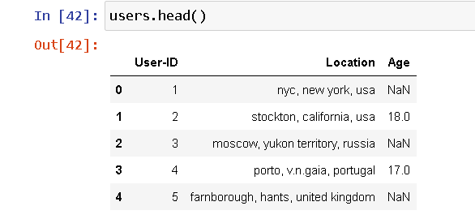
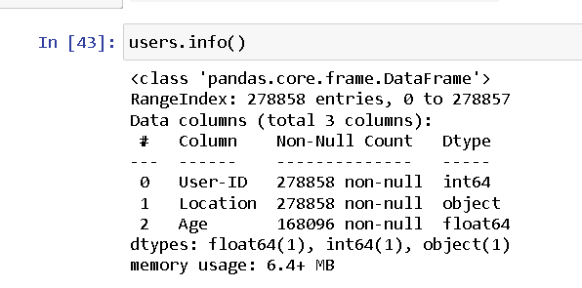
Users Data Preprocessing

Slide 11
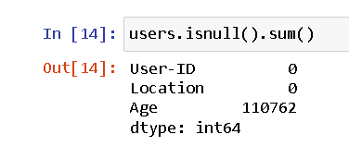
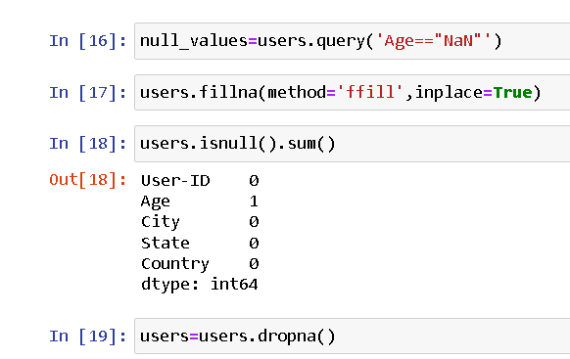
Null Values

Slide 12
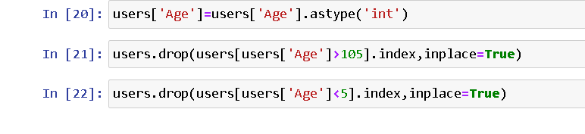
Replacing the string by int values.
Drop the Age values which were lesser than 5 and greater than 105

Slide 13
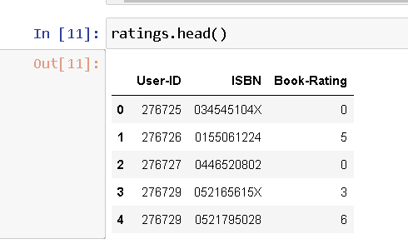
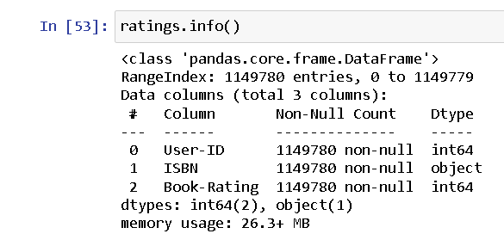
Ratings Data Preprocessing

Slide 14
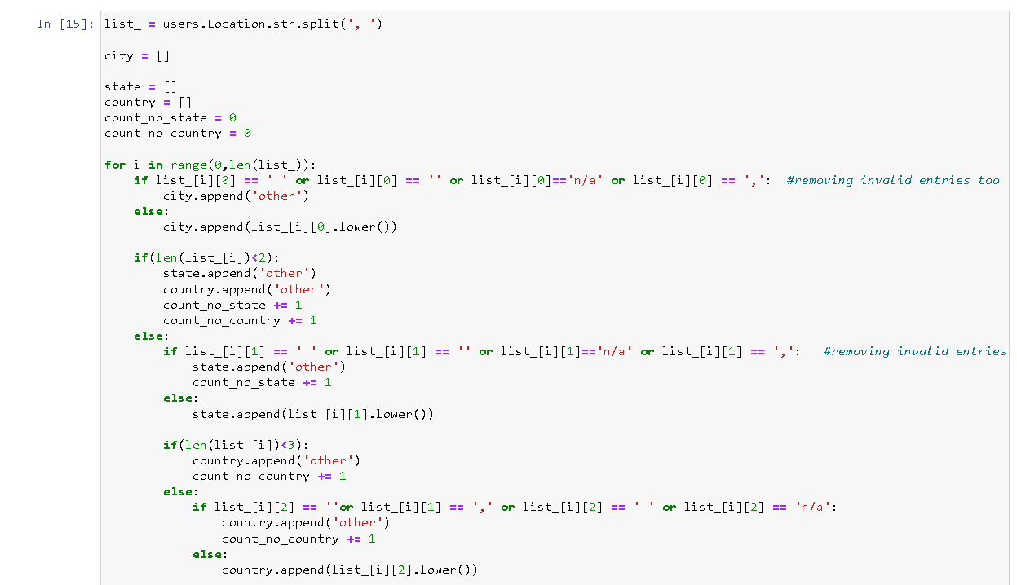

Slide 15
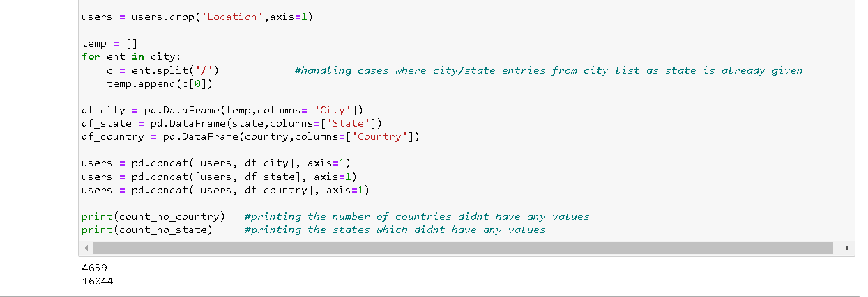
Separated Location Column column of Users Database in the City,State and Country

Slide 16
BOOK RECOMMENDATION SYSTEM
---By Group 6
Akshay B. R
Sumedh Avinash Chavan
Satish Nandu Patil
Swatipriya
Aneesh Kumar
Mohan Vishnu

Slide 17
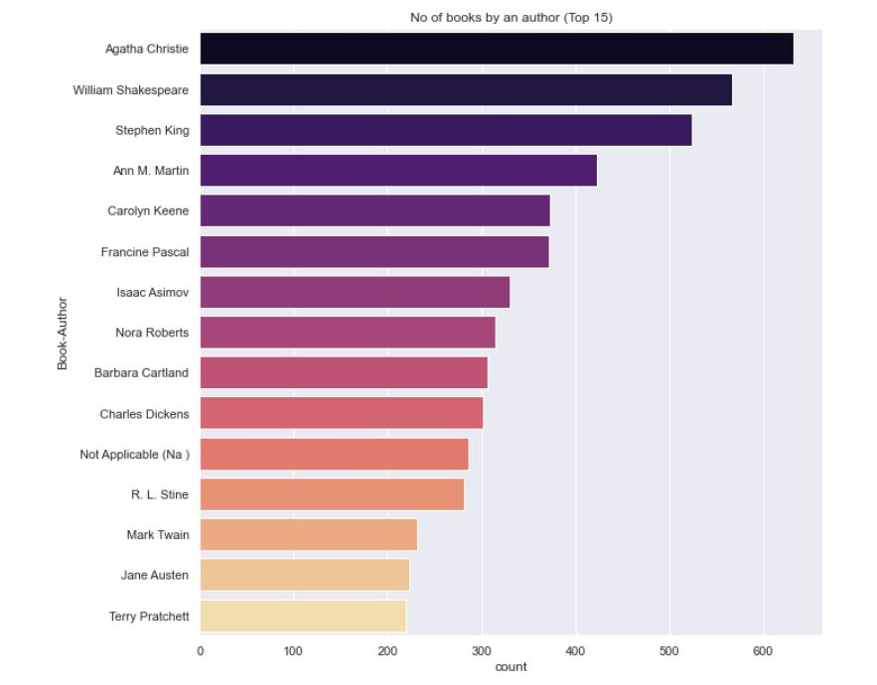
MOST NO OF BOOKS PUBLISHED BY AN AUTHOR
Agatha Christie book author has published most no of book in the give dataset
Terry Pratchett is published least no of book out of top 15

Slide 18
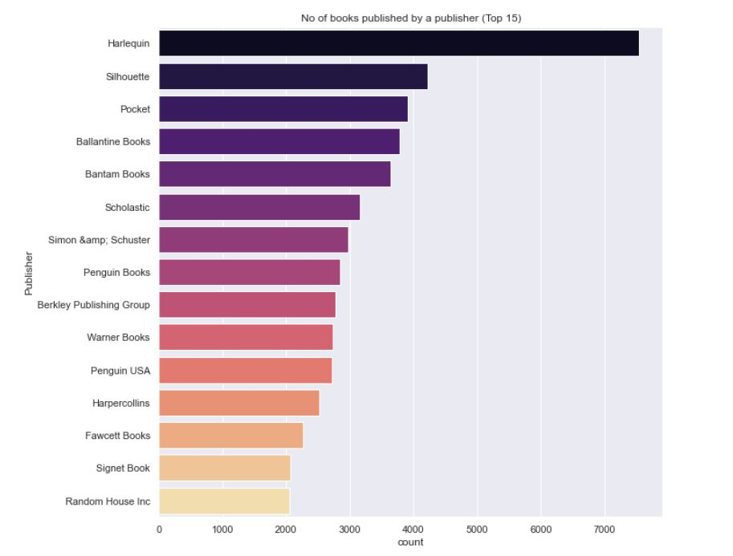
MOST NO OF BOOKS PUBLISHED BY A PUBLISHER
Hariequin has published most no of book in the given dataset
Random House Inc has published least no of book in the given dataset out of top 15

Slide 19
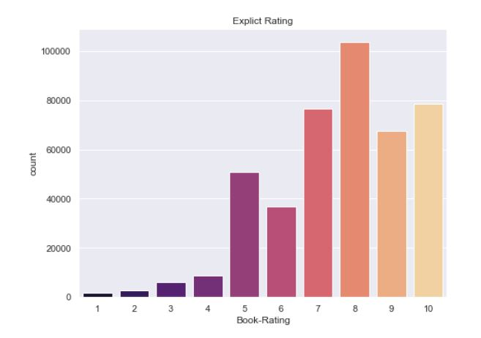
BOOK RATING
As there are two types of rating :
Implict Rating (includes 0)
Explict Rating (exclude 0)
Hence the 8 is the most no of rating is given to the book in the given dataset

Slide 20
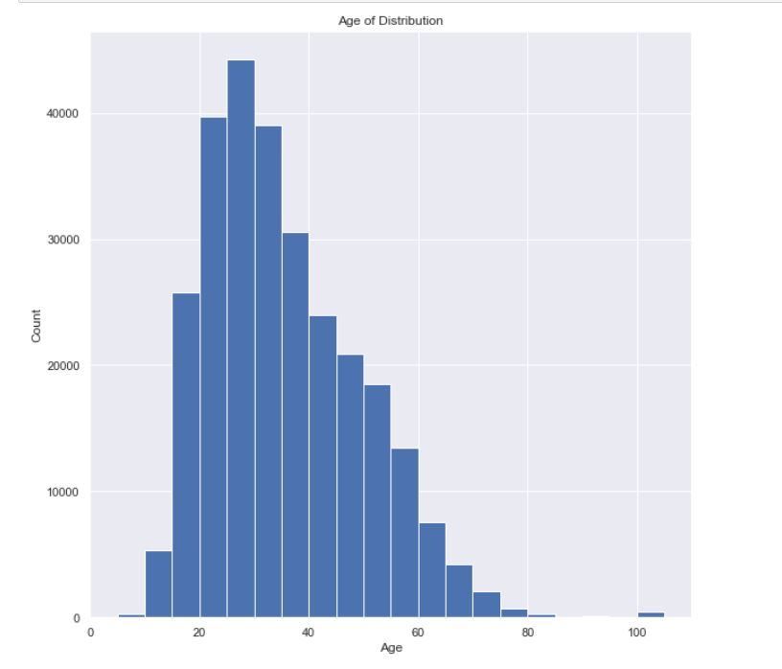
AGE DISTRIBUTION
25 to 30 age group read the most no of books
And 80 to 90 age group has read least no of books

Slide 21
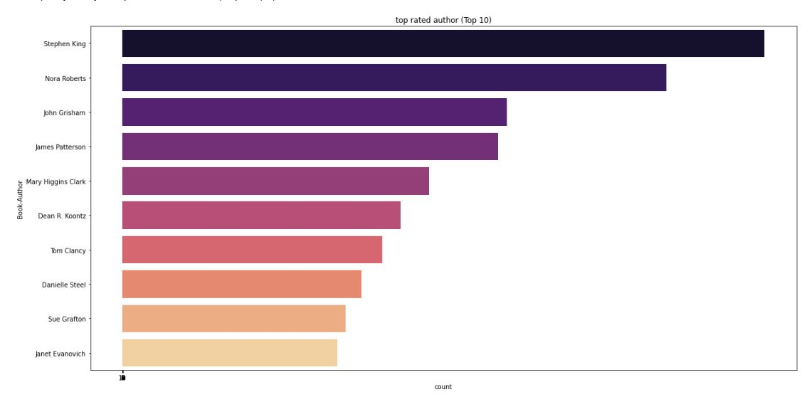
TOP RATED AUTHOR
Author Stephen King book has been most rated book in the given database
Janet Evanovich is the least rated book in the given database out of top 10

Slide 22
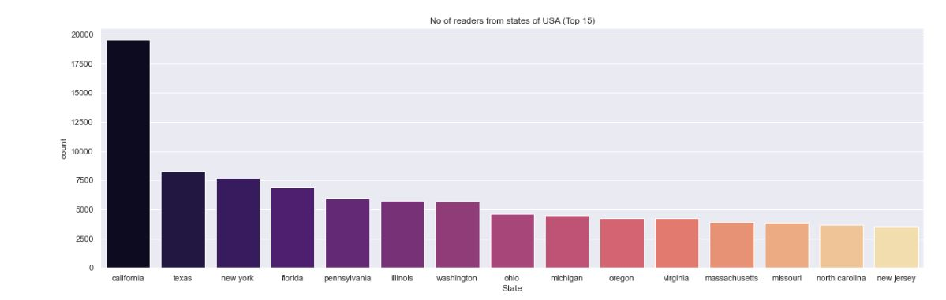
NO OF READERS FROM STATE OF USA
California state of USA has most no of readers
New Jersey of USA has the least no of readers out of top 10

Slide 23
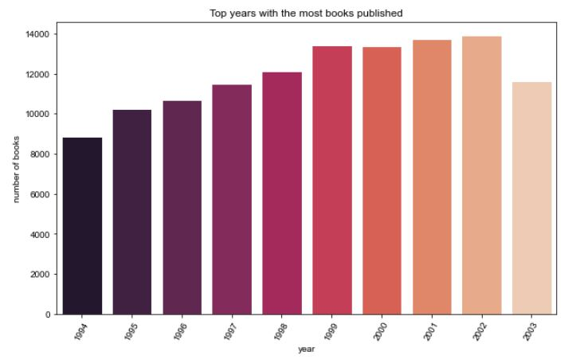
TOP YEARS WITH THE MOST BOOKS PUBLISHED
2002 Is the year with most no of book published

Slide 24
Collaborative Filtering

